Slide 1
DCS5102 – Problem Solving and programming
UNIT I PROBLEM SOLVING: Introduction – The Problem–Solving Aspect – Top Down Design – Implementation of Algorithms – Program Verification – The Efficiency of Algorithms – The Analysis of Algorithms.
UNIT II BASICS OF C PROGRAMMING: Introduction to C Programming Environment – History of C – C Standard Library – Basics of C Program Development Environment - Introduction to C Programming - A simple C Program – Memory Concepts – Arithmetic – Decision Making – Relational Operators – Assignment – Increment and Decrement Operators- Structured Program Development – Algorithms – Pseudocode- Control Structures – if , if/else Selection Structure.
UNIT III REPETITION CONTROL STRUCTURES, FUNCTIONS AND ARRAYS: Essentials of Repetition – The while, do/while Repetition Structure - Counter-Controlled Repetition – for – Multiple Selection - Switch – Break – Continue – Logical Operators Functions- Definitions - Prototypes –Header Files – Storage Classes – Scope Rules Recursion- Comparing Iteration and Recursion. Arrays – Declaration – Usage – Passing Arrays to Functions.

Slide 2
UNIT IV POINTERS, STRINGS AND AGGREGATE DATA TYPES : Pointer Variable Declarations and Initialization – Operators – Uses--Pointer Expressions and Pointer Arithmetic – Relationship between Pointers and Arrays – Arrays of Pointers – Pointers to Functions. Fundamentals of Strings and Characters – Character Handling Library - String Handling Library. StructuresDefinition – Initialization – Unions – Bitwise Operators – Enumeration Constants.
UNIT V STREAMS, FILES AND PREPROCESSOR : Streams – Formatting Output with printf –- Formatting Input with scanf. Files – Sequential-Access Files- Creation – Reading –RandomAccess Files – Creation – Reading. C Preprocessor – Introduction- #include - #define – Symbolic Constants- Macros- Conditional Compilation - #error - #pragma – Operators # and ## - Line Numbers – Predefined Symbolic Constants.
REFERENCE BOOKS:
1. R.G.Dromey, “How to Solve it by Computer”, Pearson Education, 2007.
2. H. M. Deitel and P. J. Deitel, ”C How to Program”, 7th Edition, Pearson Education, 2013.
3. Pradip Dey, Manas Ghosh, “Programming in C”, Oxford University Press, 2007.
4. Cormen,Leiserson, Rivest, Stein, “ Introduction to Algorithms”, McGraw Hill Publishers, 2002.
5. Kernigan Brian W., and Dennis M. Ritchie, “ The C Programming Language”, Second Edition, Prentice Hall, 1988.

Slide 3
Unit 1 - Problem Solving
Problem solving Aspects
Programming Paradigm
Algorithm Development
Analysis of algorithm
Levels of Programming languages

Slide 4
Introduction
There are number of problems facing in our day to day life.
Suppose we want to calculate the Simple Interest, monthly home expenses, etc.,
we need calculator to solve. But, real-time problems, scientific problems cannot solve with calculator.
So, we need a computer to solve real-time problems.

Slide 5
Introduction
A computer is a programmable machine that receives input, stores and manipulates data, and provides output in a useful format.
Computer cannot do anything without a software. Software is nothing but set of programs written to solve a particular problem.
Software is a set of instructions on the basis of which computer gives output. Computer cannot do anything without a software.

Slide 6
Never Ever Forget
Program must be planned before coding in any computer language available
If the instructions are not correct, then the computer will gives wrong output.
Just writing code is not sufficient to solve a problem.
There are many activities to be done before and after writing code.

Slide 7
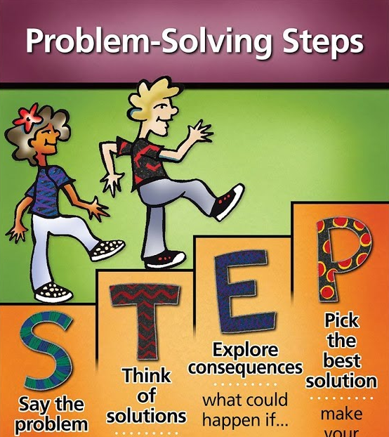

Slide 8
Problem solving Strategies
Problem Analysis
Algorithm Development
Flowcharting
Coding
Compilation and Execution
Debugging and Testing
Documentation

Slide 9
Problem Analysis
Process of becoming familiar with the problem.
Exactly identify user requirements.
To analyze and understand it well before solving.
The user’s requirements cannot be fulfilled without clear understanding of the problem in depth.
Inadequate identification of problem may cause program less useful and insufficient.
Example: Banking Solution, Hospital Medical Study

Slide 10
What is an Algorithm?
Algorithm is step by step procedure to solve a problem.
An algorithm must have finite number of steps.
Sequence of steps
INPUT
OUTPUT

Slide 11
What is an Algorithm?
Developing an algorithm is a step of program design.
Every algorithm must satisfy the following properties:

Slide 12
Properties of Algorithm
Input: There should be zero or more number of inputs given to an algorithm.
Output: An algorithm should produce atleast one output.
Definiteness: Algorithm steps should be clear and well defined.
Finiteness: The algorithm must have finite number of steps.
Correctness: Every steps of an algorithm must generate a correct output

Slide 13
An algorithm to find sum of two numbers:
Step 1: Start
Step 2: Assume two numbers x and y and a variable sum=0
Step 3: Add two numbers x and y; store the value in variable sum
Step 4: If you want to try again with different numbers then goto step 2
else
goto step 5
Step 5: END

Slide 14
An algorithm to find sum of two numbers:
Step 1: Start
Step 2: Declare variables num1, num2 and sum=0.
Step 3: Read the values of num1 and num2.
Step 4: Add num1 and num2 and assign the result to sum. sum←num1+num2
Step 5: Display sum
Step 6: Stop

Slide 15
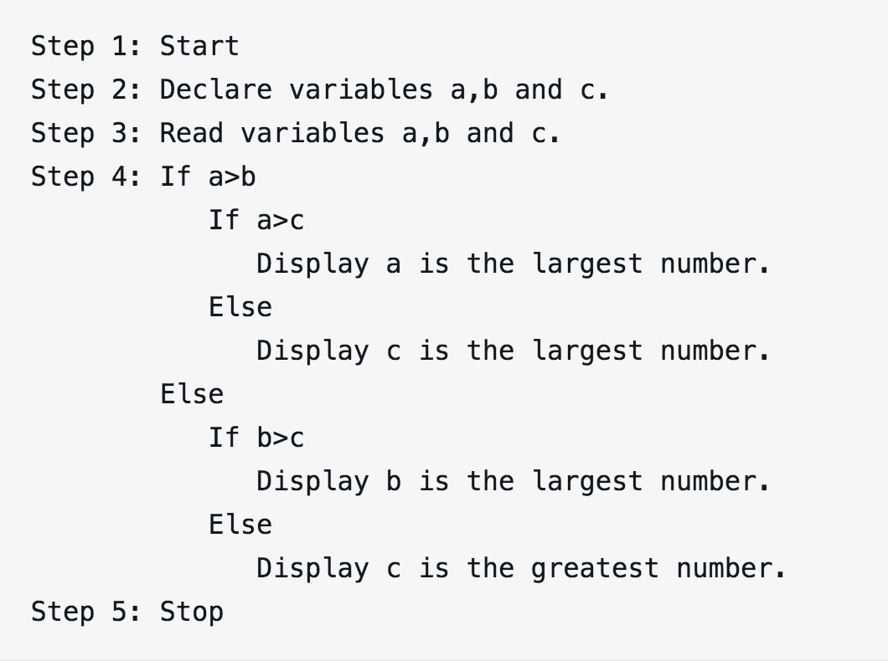
An algorithm to find largest of three different numbers:

Slide 16
features of Algorithm
Sequence
Each step in the algorithm in executed in specified order. If not algorithm will fail.
Decision
We have to make decision to do something.
If the outcome of the decision is true, one thing is done otherwise other.
If condition then process1
OR
If condition
then process1
Else process2
Repetition
For example
Repeat
Fill Water in the kettle
Until Kettle is full

Slide 17
Flowchart
Graphical representation of an algorithm using standard symbols.
Includes a set of various standard shaped boxes that are interconnected by flow lines.
Flow lines have arrows(direction of flow).
Activities are written within boxes in English.
Communicates between programmers and business persons.

Slide 18
Advantages of Flowcharts
Communication
Quickly provide logic, ideas and descriptions of algorithms.
Effective Analysis
Clear overview of the entire problem.
Proper Documentation
Documents the steps followed in an algorithm.
Helps us understand its logic in future.
Efficient Coding
More ease with comprehensive flowchart as a guide
Easy in debugging and program maintenance
Debugging and maintenance of operating program

Slide 19
Flowchart Symbols
Symbol | Name | Function
 | START AND END | An oval shape represent start or end point of the flowchart.
 | ARROWS | A line is a connector which shows relationship between the representative shapes.
 | INPUT AND OUTPUT | A parallelogram symbol represents input or output.

Slide 20
Flowchart Symbols
Symbol | Name | Functions
 | PROCESS | A rectangle represents a process
 | DECISION | A diamond symbol indicates decision
 | CONNECTOR | A connector which show a jump from one point in the process flow to another

Slide 21
How to use flowchart symbols
There should be start and stop to the flowchart.
Only one flow line should emerge from a process symbol.
Only one flow line should enter a decision symbol, but two or three flow lines can leave the decision symbol.

Slide 22
Algorithm
Write an algorithm and draw flowchart for finding the sum of any two numbers.
Step1: Start
Step2: Display “Enter two numbers”. Step3: Read A and B
Step4: C= A+B
Step5: Display “C as sum of two numbers” Step6: Stop

Slide 23
Flowchart
START
Start
Read two Numbers, A and B
Input
Processing
C = A + B
Output
Display C as Sum of A and B
End
END

Slide 24
Coding
Coding is the process of transforming the program logic design into computer language format.
An act of transforming operations in each box of the flowchart in terms of the statement of the program.
The code written using programming language is also known
as source code.
Coding isn’t the only task to be done to solve a problem using computer.
Anyone can code, but most know the language enough.

Slide 25
Compilation
Compilation is the process of changing high level language into machine level language.
It can be done by using a special software called COMPILER.
The compilation process tests the program whether it
contains syntax errors or not.
If syntax errors are present, compiler can not compile the code.

Slide 26
Execution
Once the compilation is completed then the program is linked with other object programs needed for execution, there by resulting in a binary program and then the program is loaded in the memory for the purpose of execution and finally it is executed.
The program may ask user for inputs and generates outputs after processing the inputs.

Slide 27
Debugging and Testing
Debugging is the process of discovery and correction of programming errors.
Some errors may remain in the program because the programmer might have never thought/identify about a particular case.
When error appears debugging is necessary. Testing ensures that program performs correctly the required task.

Slide 28
Debugging and Testing
Verification ensures that program does what the programmer intends to do.
Validation ensures that the program produces the correct results for a set of test data.
Test data are supplied to the program and output is observed.
Expected output is nothing but Error free.

Slide 29
Documentation
Helps to those who use, maintain and extend the program in future.
A program may be difficult to understand even to programmer who wrote the code after some days.
Properly documented program is necessary which will be useful and efficient in debugging, testing, maintenance and redesign process.

Slide 30
Two types of documentations
Programmer’s Documentation (Technical Documentation)
Maintain, redesign and upgrade
Logic, DFD, E-R, algorithm and flowchart
User Documentation (User Manual)
Support to the user of the program
Instructions for installation of the program

Slide 31
PROGRAMMING PARADIGM
The systematic and organized principle of writing a program is called as programming paradigm.
There are many programming approaches have been developed and used so far.
Procedural Programming Approach
Structured Programming Approach
Modular Programming
Top-Down Design
Bottom-Up Design

Slide 32
Procedural Programming Approach
The problem can be solved as a sequences of steps such as reading, processing and printing.
It mainly focus on processing. i.e., find the best algorithm to perform computation.
Every function can utilized the global data.
BASIC, FORTAN , PASCAL.
Drawbacks:
It does not model real world problem very well.
If the program size is large, it is very difficult to identify which function can use what data and type of it.
Reusable of code is not allowed.
This approach is very difficult to understand and maintain.
Due to open available, global data are more vulnerable.

Slide 33
Structured Programming Approach
In this approach, the problem is break down into separate pieces of modules.
Each modules is computed separately, So modification in programs becomes much easier.
Structured procedures can be used for writing complex program which reduce error and also easier to debug.
Several programmers can write code simultaneously.
It consists of three types of elements, such as selection statements, Sequence Statements and Iteration statements. Ex. C, C++,

Slide 34
Structured Programming Approach
Drawbacks:
It is Machine-Independent, so, it takes time to convert into machine code.
It is language – dependent, so, program development takes longer time.
Updating the program frequently, since program depends upon changeable factors like data –types. Constant values.

Slide 35
Modular Approach
Large program is breakdown into sub-programs.
A system is exactly partitioned into modules. Each modules can be developed separately.
A module can be a macro, procedure, function, process or package.
A program can be logically separated into the following modules,
Initialization,
Input
Input data validation
Processing
Output
Error handling
Closing Procedure.

Slide 36
Modular Approach
Advantages:
Modules can be reused any where in the program. So, decreases the duplication of code.
Easier to code and a module can use other module, so, decreases the complexity.
Debugging is done easier, since modules are isolated.
Documentation of larger program is simplified by doing documentation of individual modules.
Ex: methods in Java.

Slide 37
Top – Down Design
Top – Down design identify major modules on the program. Initially Start to implement the main module.
The main modules are decomposed into several lower level modules and iterating until the desired level of details is achieved. i.e., no more refinement is required.
Advantages:
It can used when the design is not detailed enough.
At each stage, sub-programs are tested individually. So, debugging is easier.
In this design, the entire program can be traversed easily.
Disadvantage:
It is suitable only if we know the specifications of the system clearly.
System development starts from the scratch. So very careful while developing.

Slide 38
Bottom – Up Design
Bottom –Up design approach starts with designing the most basic module and proceeds to next higher level modules.
Initially, it starts to implement from lower level module and then implement the next higher level and iterating the process until it reaches the top level.
It work with layer of abstraction.
Advantages:
It is very suitable when designing the complex systems like operating system, complier design, networking software systems etc.,
It conceptualized layered architecture which is best for implementing complex programs that is reliable and maintainable.

Slide 39
Analysis of Algorithm
Space Complexity: Amount of space required by the algorithm, during the course of its execution. An algorithm requires space for the below components
* Instruction Space: To store the executable version of the program.
* Data Space : To store all variables and constant values.
* Environment Space: Space required to resume suspended function.
Time Complexity: Amount of time required by the program to run until the completion taken place.
Time complexity and space complexity cannot be exactly measured.
Exactly can’t say how much space can be utilized during execution.
Exactly cann’t define the exact time required by an algorithm. These can be expressed in terms of some standard notations such as asymptotic notations.

Slide 40
Asymptotic Notations
Asymptotic Notations:
Analyze the complexity of an algorithm in terms terms of space and time in asymptotic sense.
Asymptotic Behaviour:
Asymptotic means some sort of limits taken. As the input size of an algorithm increase, the running time also increase. This is known as algorithm’s growth rate.
Types of Asymptotic Notations:
* Big Oh(O)
* Big Omega(Ω)
* Big Theta(θ)

Slide 41
Asymptotic Notations
There are three cases to analyze an algorithm: 1) Worst Case 2) Average Case 3) Best Case
Worst case is the function which performs the maximum number of steps on input data of size n.
Average case is the function which performs an average number of steps on input data of n elements.
Best case is the function which performs the minimum number of steps on input data of n elements.

Slide 42
Asymptotic Notations
The best time complexity in Big O notation is O(1)
Big Oh(O) represents the upper bound of the running time of an algorithm. specifically describes the worst-case scenario, and can be used to describe the execution time required or the space used.
BIG Omega notation represents the lower bound of the running time of an algorithm. Thus, it provides best case complexity of an algorithm.
Big Theta (θ) notation represents the upper and the lower bound of the running time of an algorithm, it is used for analyzing the average case complexity of an algorithm.

Slide 43
Programming
Set of instructions that causes to behave in predetermined manner.
To instruct a computer to perform a certain job, we need languages, but not English or French.
We need languages understood by the computer. i.e., Programming languages.

Slide 44
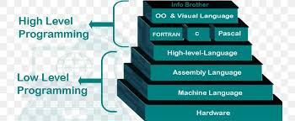
Levels of Programming Languages
High Level
Low-level
Machine Level
Assembly Level

Slide 45
Low Level Language
Set of program statement or instruction is directly translated into a single machine code.
It is machine dependent, i.e. A particular low- level language works only for a certain machine.
Difficult to understand and program.

Slide 46
Machine Level Language
Machine Level Language is a sequence of instructions written in the form of binary numbers consisting of 1’s and 0’s.
Actually the computer understands only 1’s and 0’s form of codes.
It executes the codes very fast as computer don’t need any translation.

Slide 47
Machine Level Language
Advantages:
Computers directly understand machine instruction. So, it start executing immediately.
It takes very less execution time.
Disadvantages:
It is machine dependent.
Difficult to use, modify and debug the code.

Slide 48
To add two number in machine language:
11 | 10111001 | 110
3 | machine code for addition (say) | 6
It is difficult to remember different instructions for programming.

Slide 49
Assembly Language
It is a Symbolic representation(mnemonics) of machine code.
Close to machine code but the computer cannot understand
Assembler is used to translate the assembly code into machine code.
10 ADD 100
– ADD is mnemonic for addition
SUB 1001
- SUB is mnemonic for subtraction.

Slide 50
Assembly languages Instructions
CODE | Meaning
ADD | Addition
SUB | Subtraction
INR | Increase
DCR | Decrease
CMP | Compare
MUL | Multiplication
It is relatively easy for writing programs in assembly languages, but is slow in execution as it has to be converted into machine language before execution.

Slide 51
Assembly language
Advantage | Disadvantage
More convenient than machine language | Hard to remember Mnemonics
Symbolic instructions | Machine dependent
Improved readability | Less efficient than machine language
Need fewer codes than high level language
Embedded systems and device programming

Slide 52
High Level Language
User friendly, Similar to natural languages
Platform independent
Easy to write or remember
Easy to learn and work
While execution: translated into assembly language then to machine language.
Slow in execution but is efficient for developing programs.
Ex: C, C++, Python, Java etc.

Slide 53
High Level Language
Advantages | Disadvantages
Easy to use | More execution time
Portability | Needs own translator
Easy Debugging
Easy and Fast Development of software

Slide 54
Compiler
A high level source program must be translated into a form machine can understand. This done by software called the compiler.
Source code => Machine language code(Object code)
During the process of translation, the compiler reads the source
programs statement-wise and checks for syntax errors.
In case of any error, the computer generates message about the error.
Ex: C, C++, Java, FORTRAN, pascal etc.

Slide 55
Interpreter
Like compiler, it is also a translator which translates high level to machine level language.
Translates and executes the program line by line.
Each line is checked for syntax error and then converted to
the equivalent machine code.
Ex. QBASIC, PERL, PHP, ASP, PYTHON, RUBY

Slide 56
Difference between compiler and interpreter
Compiler | Interpreter
Compiler scans the entire program before translating it into machine code | Interpreter translates and executes the program line by line
Syntax errors are found only after the compilation of complete programs | Syntax errors can be trapped after translations of every line
It takes large amount of time to analyze the source code but the overall execution time is comparatively faster. | It takes less amount of time to analyze the source code but the overall execution time is slower.
Generates intermediate object code which further requires linking, hence requires more memory. | No intermediate object code is generated, hence are memory efficient.

Slide 57
ANY Questions ?

